Slide 1
Computational models
Goal: Define, understand, quantify, and visualize a phenomenon or system by generating an appropriate model that conceptually represents its structure

Slide 2
Categories of models
Decision making models
Sequential Decision Making (SDM) : Provide a mathematical framework for modeling decision making in cases where outcomes are partially random and partially under the control of a decision maker
Markov decision processes(MDP) [182]–[184]
Partially observable Markov Decision processes (POMDPs) [183], [185]
Multi Armed Bandits (MABs) [186], [187]
Goal: find the optimal decision strategy that optimizes (maximize or minimize) a certain objective
Application: physical activity tracking for obesity, stroke rehabilitation, assisting people with dementia , stress management interventions
Explicit vs Implicit
Ruled Based
Linear vs Non-linear
Deterministic vs Probabilistic(Stochastic)
Dynamic vs Static
Discrete vs Continuous
Decision making models
Notes:
complex and uncertain with respect to the treatment outcomes and costs associated with different diagnostic tests, such models are expressive enough to capture the interaction among all relevant features.

Slide 3
Multi Armed Bandits (MABs)
Maximize the reward obtained by successively playing gamble machines (the ‘arms’ of the bandits)
Invented in early 1950s by Robbins to model decision making under uncertainty when the environment is unknown
The lotteries are unknown ahead of time
Assumptions
Each machine 𝑖 has a different (unknown) distribution law for rewards with (unknown) expectation 𝜇𝑖 :
Successive plays of the same machine yield rewards that are independent and identically distributed
Independence also holds for rewards across machines
Notes:
1. https://www.lri.fr/~sebag/Slides/Venice/CesaBianchi.pdf

Slide 4
Formal representation
Reward = random variable 𝑋𝑖,𝑛 ; 1 ≤ 𝑖 ≤ 𝐾, 𝑛 ≥ 1
𝑖 = index of the gambling machine
𝑛 = number of plays
𝜇𝑖 = expected reward of machine 𝑖.
A policy, or allocation strategy, 𝐴 is an algorithm that chooses the next machine to play based on the sequence of past plays and obtained rewards.
Challenges:
Deciding on the detailed structure of the state
Size of the state space (i.e., a fine grained state space yields better decision strategies but leads to more complicated models)
Data limitations (e.g., for some state control pairs, there may be no observations)

Slide 5
Model Selection
A priori Information
Subjective information
Data Analysis
Relationship Estimation
Methods
Optimal Design of Experiments:
When we wish to decide among different models, we can design a set of experiments that can help us identify the model that best describes our data
Regression Analysis: Estimate the regression function, which is a function of an independent variable, i.e., Y ≈ f (X, β)
Log-linear analysis: Determine if there is a statistically significant relationship among three or more discrete valued variables
Criteria
Akaike Information Criterion (AIC) : AIC = 2k − 2 ln p(y|θˆ), relative quality of models for a given set of data
Bayesian Information Criterion (BIC): Among finite set of model,BIC = k · ln (n) − 2 ln p(y|θˆ), model with the lowest BIC is preferred

Slide 6
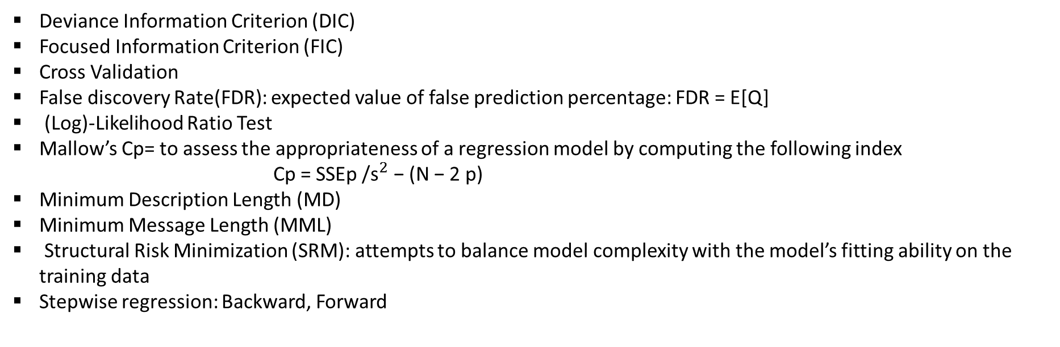
Deviance Information Criterion (DIC)
Focused Information Criterion (FIC)
Cross Validation
False discovery Rate(FDR): expected value of false prediction percentage: FDR = E[Q]
(Log)-Likelihood Ratio Test
Mallow’s Cp= to assess the appropriateness of a regression model by computing the following index
Cp = SSEp /${\text{s}}^{2}$ − (N − 2 p)
Minimum Description Length (MD)
Minimum Message Length (MML)
Structural Risk Minimization (SRM): attempts to balance model complexity with the model’s fitting ability on the training data
Stepwise regression: Backward, Forward
Bayes factor:
Goal: To decide between two statistical models based on the probability of a model M given data D determined by the Bayes rule: Pr (M|D) = Pr (D|M) Pr (M) /Pr (D)
Bayes factor: Ratio of the probabilities of observing the data D under the two assumed models:
K = Pr (D|M1) /Pr (D|M2)
Notes:
2

Slide 7
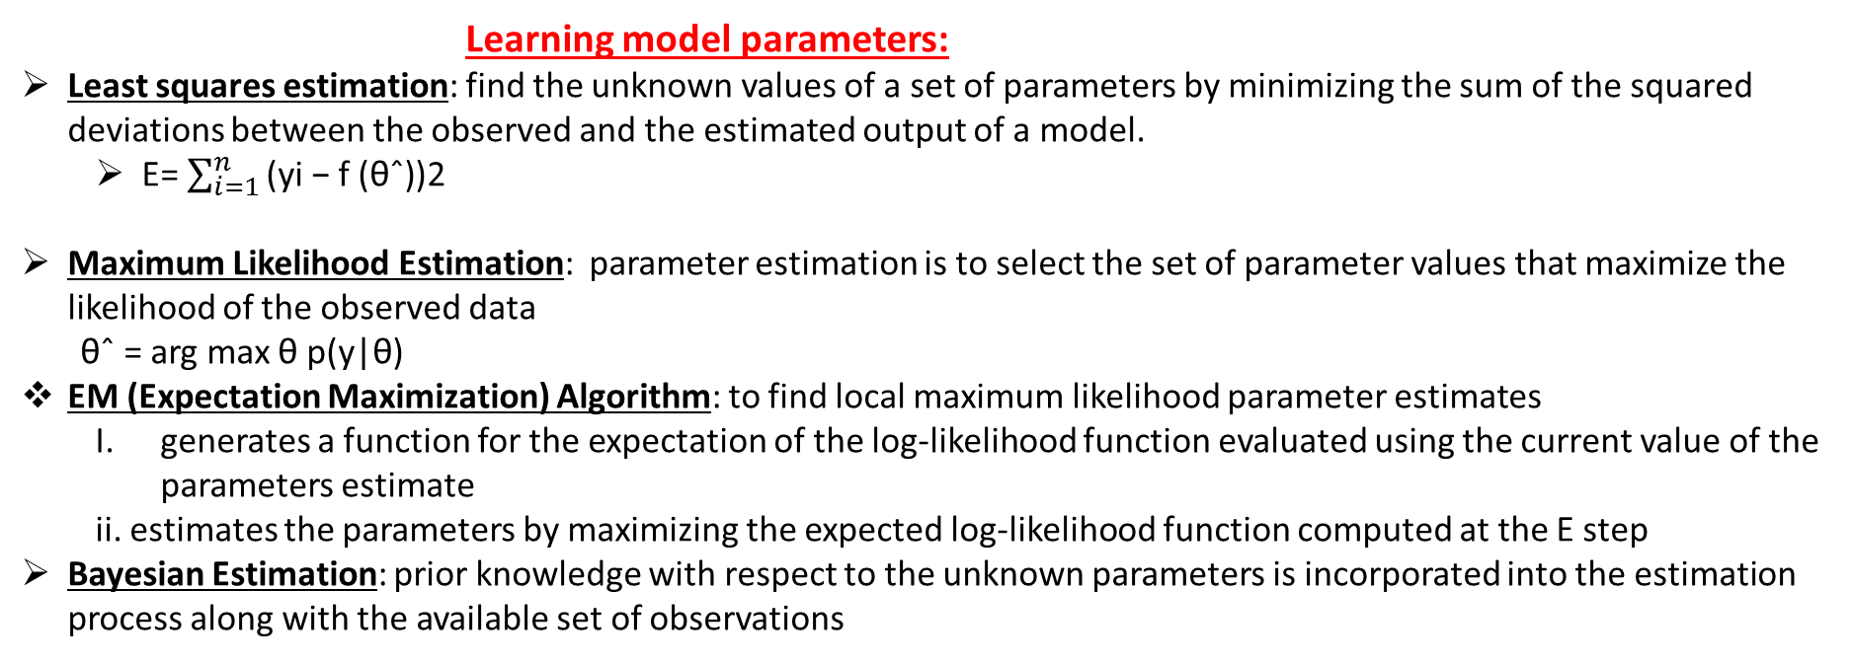
Model Evaluation
Confidence interval, confusion matrix, gain & lift chart, Kolmogorov-Smirnov chart, χ 2 , ROC curve, Gini coefficient, RMSE, and L1 version of RMSE
Learning model parameters:
Least squares estimation: find the unknown values of a set of parameters by minimizing the sum of the squared deviations between the observed and the estimated output of a model.
E= $\sum_{i=1}^{n}{\text{(}\text{yi}\text{ − }\text{f}\text{ (}\text{θ}\text{ˆ))2} }$
Maximum Likelihood Estimation: parameter estimation is to select the set of parameter values that maximize the likelihood of the observed data
θˆ = arg max θ p(y|θ)
EM (Expectation Maximization) Algorithm: to find local maximum likelihood parameter estimates
generates a function for the expectation of the log-likelihood function evaluated using the current value of the parameters estimate
ii. estimates the parameters by maximizing the expected log-likelihood function computed at the E step
Bayesian Estimation: prior knowledge with respect to the unknown parameters is incorporated into the estimation process along with the available set of observations

